Slide 1

Movie Data Analysis
Prasad Kalambe

Slide 2

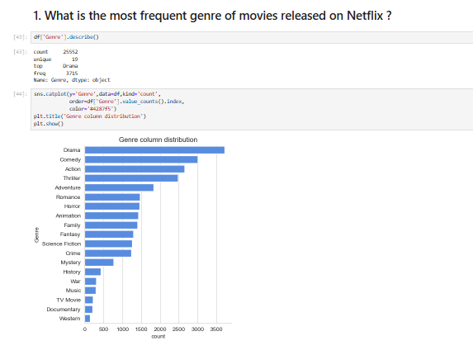
Netflix Movie Data Analysis Project
What is the most frequent genre of movies released on Netflix?

Slide 3
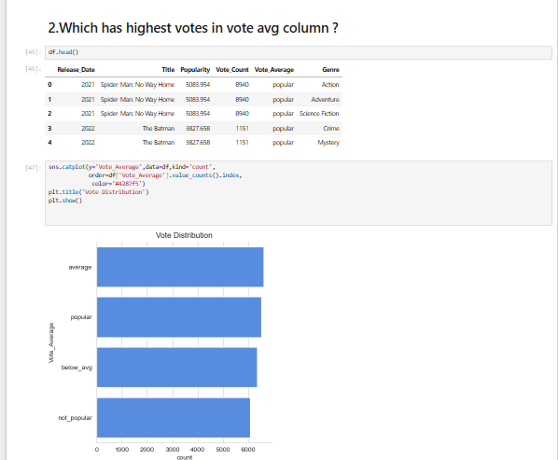
Netflix Movie Data Analysis Project
2) Which has highest votes in vote avg column?

Slide 4

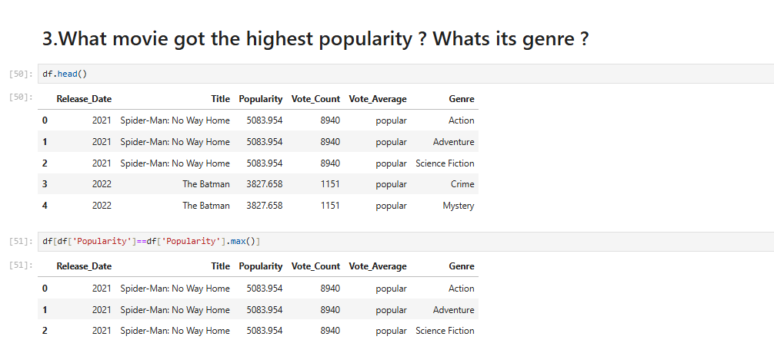
Netflix Movie Data Analysis Project
3) What movie got the highest popularity? what's its genre?

Slide 5
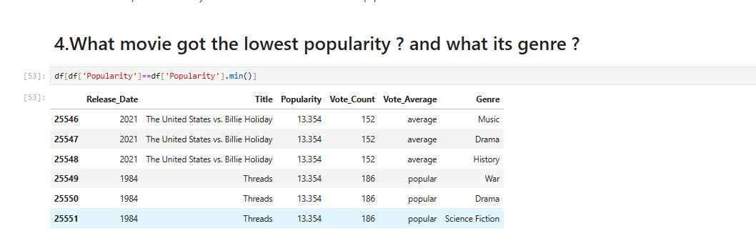
Netflix Movie Data Analysis Project
4) What movie got the lowest popularity? what's its genre?

Slide 6
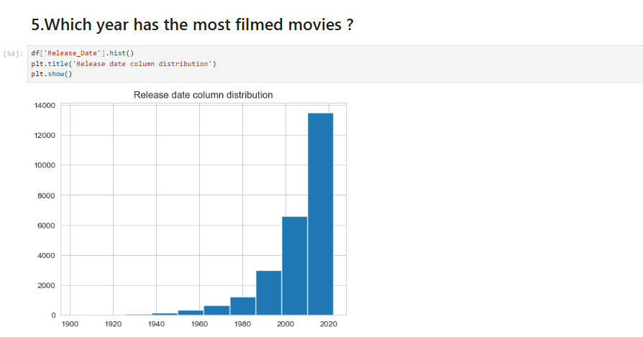
Netflix Movie Data Analysis Project
5) Which year has the most filmmed movies?

